Slide 1
data visualization
Introduction to Tableau

Slide 2
AGENDA
Why are we here today?
Journey of Business Intelligence (BI)
What is Tableau?
DEMO
Closing notes

Slide 3
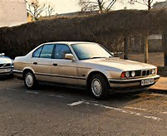

Why are we here today?
Yale’s need to leap into next generation Business Intelligence (BI)
Provide self-service intuitive interfaces for visualizing collected data
Take the mundane tasks of technology and put it on a fast track to data visualization
Give you back time to do what really matters

Slide 4
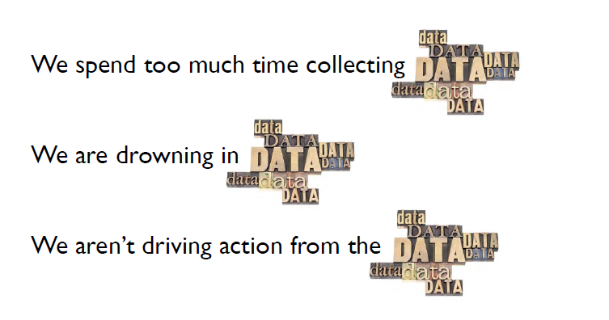
WHY are we here today?
We need to be
Decision Driven
Supported by factual evidence in data

Slide 5
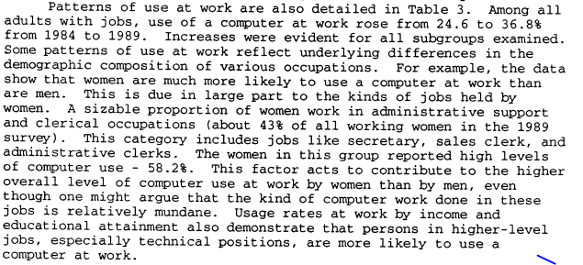
THis is how we read reports

Slide 6
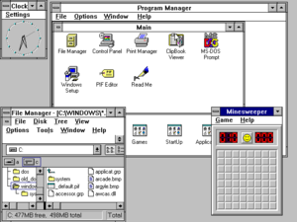
the good old days

Slide 7
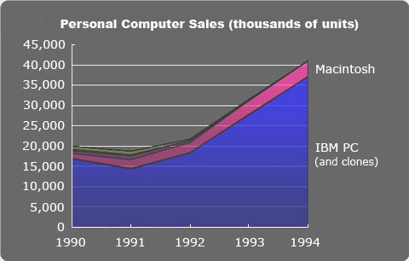
THEN CAME graphs (our use matured)

Slide 8
let’s state the obvious
Technology has matured
Our use has matured
Our needs have evolved
As humans,
we are wired to learn faster visually than any other means
we need tools that relate closely with our Natural Senses to understand the world around us
we like the phrase,
“A Picture is worth a 1,000 words!”
A Case for data visualization

Slide 9
WHat is data visualization
A clear portrayal of complex relationships
with insight in behaviors, not pictures
it is no longer a function of the specialists
WHY is it IMPORTANT?
Speed - time to value
Empowers business users
Enables self-driven data discovery
IT does what it knows best, you do what you know best

Slide 10
ACTUAL Customer requirements
Our users are traditionally used to a lot of reporting services reports - is there an elegant way to connect Tableau with reporting services and automatically pass parameters and data between the two?
Can I set up data driven alerts which trigger emails and/or other behavior? Can we schedule email of a dashboard without a data driven event?
Can I get a 3D bar chart or pie chart?
It seems that I can apply gradient color on tables. Can I just apply it just on specific columns, instead of the whole table?
Do you have an excel plugin to use PivotTables in Excel on your data?
Report bursting | Ability to send the reports across to multiple Users.
Exports to Other Formats( PDF, Excel, PDF,CSV, etc) | Data view to be exported to various format for in-depth Analysis
export interactive PivotTables | Ability to export interactive PivotTables to Excel

Slide 11


Slide 12
what is tableau
A Self-Service BI tool (SSBI) that can render your data in quick, easy to consume way
It takes the guess work out of many of the report generation tasks

Slide 13
WHERE DOES tableau fit in?
Databases
ETL
Spatial
Advanced Analytics
Data Mart
Rapid BI
Extract
Federate
Transform
Cleanse
Enrich
Star Schema
Archive
Time Slice
What-If
Real-Time
Source
Systems
Spatial
Enrichment & Operations
Statistics
Prediction
Analyze Visually
Oracle
SQL Server
Talend
ArcGIS
SAS
Composite
Tableau
Open Source
R/Rattle UI
“Free”
Excel
Freemium+
Lavastorm
trial available
Alteryx
* This list is an incomplete list. There are many solutions in the marketplace. Warehousing is an activity achieved along the way after ETL. This is merely representational.

Slide 14
why tableau
Best of breed, industry leading and FUN data visualization.
Unleashing business intelligence for the subject matter expert
Use complimentary tools for:
Complex, unstructured data sources including XML
Geocoding deeper than postal code
Generation of polygons for sales territories or trade areas
Demographic and behavioral analysis
Advanced statistics using R
Additional tools to perform ETL-like processes beyond the Tableau data re-shaper and to handle cleansing, MDM

Slide 15
DEMO

Slide 16
IN CLOSING
Tableau is great but use with caution
There is no “One Size Fits All” in BI space
Other tools fit other needs
Make right decisions with the choice of tool to:
fulfill the Highest Level Objective
weigh the ROI vs. Alternates
refocus evaluation
There are Business Units within Yale already using Tableau (eg. Public Safety, Procurement etc.)
Connect, Learn, Collaborate, Grow
WAIT! there’s more

Slide 17
QUESTIONS?

Slide 18
Thank YOU!

